Slide 1

Securing IoT
5G Network Security Infrastructure
Video 5.4

Slide 2
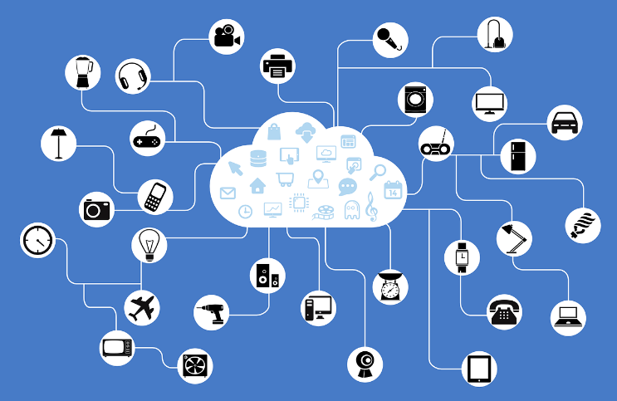
Internet of Things (IoT)
Definition
“The Internet of things describes the network of physical objects—a.k.a. "things"—that are embedded with sensors, software, and other technologies for the purpose of connecting and exchanging data with other devices and systems over the Internet.” – Wikipedia
Global Market for IoT
2020: US $309 billion
2028: US $1.9 trillion
Notes:
Picture downloaded from Pixabay: https://pixabay.com/vectors/network-iot-internet-of-things-782707/

Slide 3

IoT is Vulnerable
OWASP 2018 Study:
Weak Guessable, or Hardcoded Passwords
Insecure Network Services
Insecure Ecosystem Interfaces
Lack of Secure Update Mechanism
Use of Insecure or Outdated Components
Insufficient Privacy Protection
Insecure Data Transfer and Storage
Lack of Device Management
Insecure Default Settings
Lack of Physical Hardening
Notes:
Picture downloaded from Pixabay: https://pixabay.com/vectors/network-iot-internet-of-things-782707/

Slide 4
Securing IoT Devices
Security Credentialing
IoT SAFE:
Goes beyond security perimeter and traditional cybersecurity.
Provides trusted authentication for IoT devices, and it can also extend to protecting and encrypting data that IoT transmits.
Subscriber identity module Applet For secure End-to-end communication.
GSM Association
An industry organization of more than 750 mobile operators and 400 companies.

Slide 5
IoT SAFE
Data exchange via Transport Layer Security (TLS).
TLS is IETF standard for encryption, authentication, and integrity.
IoT SAFE embodied as Java Card applet on SIM and performs TLS operations.
Reduces complexity with security functions invisible to applications.
Credentials:
Preloaded into SIM.
When placed into network.
Secure data vault.
Notes:
Picture downloaded from Pixabay: https://pixabay.com/vectors/network-iot-internet-of-things-782707/

Slide 6
Benefits to 5G
IoT SAFE
Major Security Improvement More secure and protects devices from attack.
Seamless Onboarding Allows secure and fast access to mobile network.
Standards Based Designed to utilize TLS.
Zero Touch Provisioning Seamless provisioning with pre-loaded credentials.

Slide 7
Network Security Principles for IOT
5G Mobile Network Operators
Identification & Authentication To enable service entities.
Data Protection To guarantee security and privacy.
Processes & Mechanisms To guarantee availability.
Access Control To create the IoT Service.

Slide 8
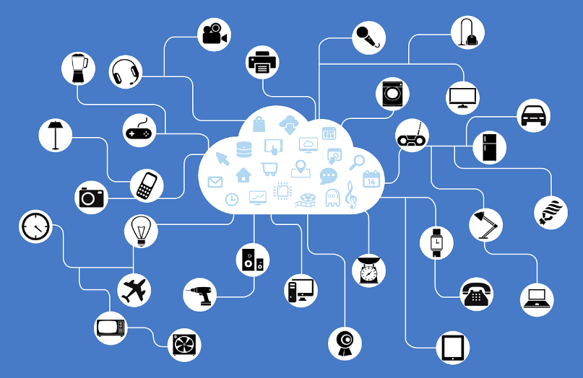
Key Takeaways
01
Act to Protect IoT
Device and Network Level.
02
Device Security
Security credentialing via IOT SAFE.
03
5G Mobile Networks
Utilize network security principles.

Slide 9
VNF and CNF Security
Next Video

